Slide 1
Team-2 Web Presentation
Present :
FlexBMI
(bit.ly/FlexBMI)

Slide 2
Background
Obesity is common, serious and costly
More than 1/3 (34.9% or 78.6 million) of U.S. adults are obese. [source : abstract Journal of American Medicine (JAMA)]
Obesity-related conditions include heart disease, stroke, type 2 diabetes and certain types of cancer, and some of the leading causes of preventable death.
The estimated annual medical cost of obesity in the U.S. was $147 billion in 2008 U.S. dollars; the medical costs for people who are obese were $1,429 higher than those of normal weight.

Slide 3
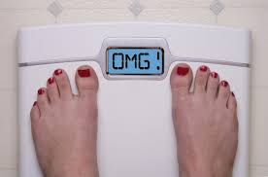
Background (Cont.)
2. Underweight Problem (ex: anorexia, malnutrition, extreme diet method)
3. Difficult to determine weight status → relative for each person

Slide 4
We Offer Solution!
FlexBMI (bit.ly/FlexBMI)
developed by :
  Ucu Nurul Ulum (Frontend Developer)
  Mochamad Tegar Utomo (UI designer)
  Husain Athfal Hidayat (Technical Writer)

Slide 5
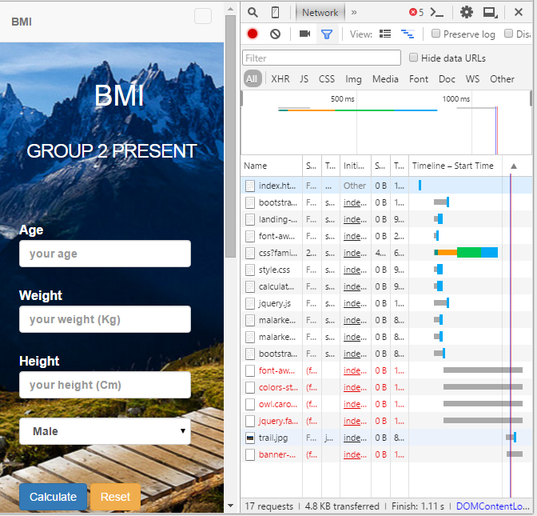
FlexBMI (bit.ly/FlexBMI)
A lightweight web apps, yet responsive to any gadget.
(17 Requests, 4.8 Kb Transferred, Finish 1.11)
Easy to use

Slide 6
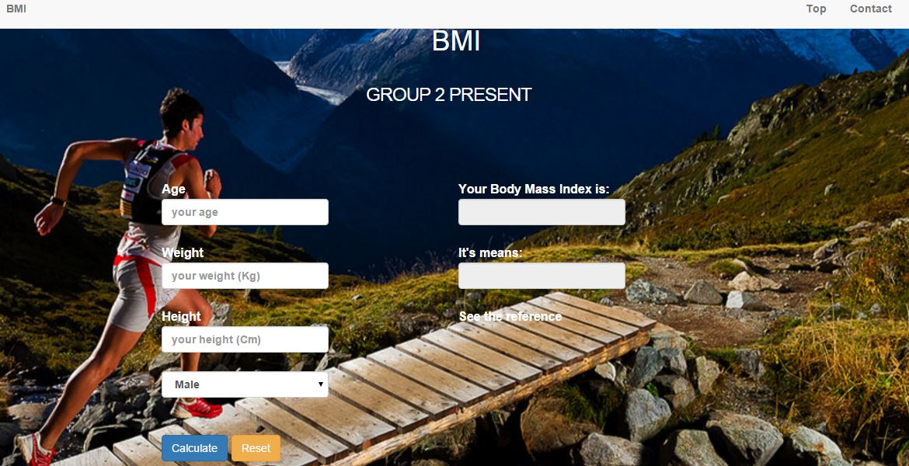
FlexBMI (bit.ly/FlexBMI)
Benefit:
Help people to know their BMI status based on their current weight, height, gender, and age.
Find user's ideal weight based on age and gender.
Find user's healthy weight if you want to lose weight or are on diet.

Slide 7
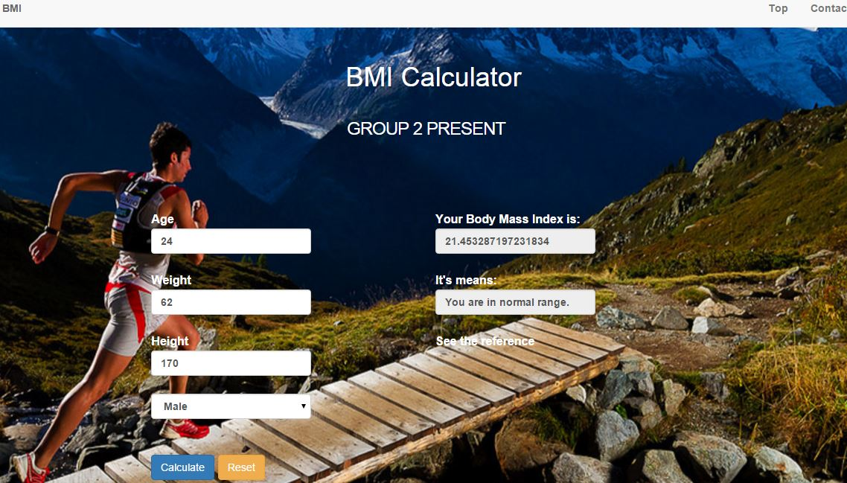
How to Use FlexBMI?
Just double click on index.html located in folder repository (bit.ly/FlexBMI) and you can start using our web apps.
Input your Age, Weight (in kg), Height (in cm), and Gender then press Calculate Button

Slide 8
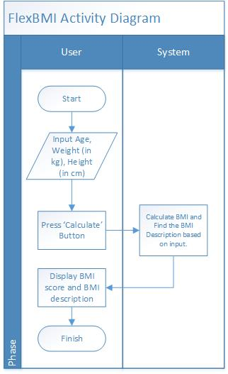
FlexBMI Activity Diagram

Slide 9




FlexBMI Development Kit

